Slide 1
The American Yawp
A Free and Online, Collaboratively Built American History Textbook
A Free and Online, Collaboratively Built American History Textbook
Notes:
Roy Rosenzweig, “Can History Be Open Source? Wikipedia and the Future of the Past,” The Journal of American History (June 2006), 119.

Slide 2
Have the digital humanities fulfilled their democratic promise?
Notes:
Roy Rosenzweig, “Can History Be Open Source? Wikipedia and the Future of the Past,” The Journal of American History (June 2006), 119.

Slide 3
Have the digital humanities fulfilled their democratic promise?
What practical problems can the digital humanities solve?
Notes:
Roy Rosenzweig, “Can History Be Open Source? Wikipedia and the Future of the Past,” The Journal of American History (June 2006), 119.

Slide 4
Have the digital humanities fulfilled their democratic promise?
What practical problems can the digital humanities solve?
How should historians collaborate?
Notes:
Roy Rosenzweig, “Can History Be Open Source? Wikipedia and the Future of the Past,” The Journal of American History (June 2006), 119.

Slide 5
Have the digital humanities fulfilled their democratic promise?
Notes:
Roy Rosenzweig, “Can History Be Open Source? Wikipedia and the Future of the Past,” The Journal of American History (June 2006), 119.

Slide 6
“Could we, for example, write a collaborative U.S. history textbook that would be free to all our students?”
Roy Rosenzweig, 2006
Notes:
Roy Rosenzweig, “Can History Be Open Source? Wikipedia and the Future of the Past,” The Journal of American History (June 2006), 119.

Slide 7
What practical problems can the digital humanities solve?
Notes:
Roy Rosenzweig, “Can History Be Open Source? Wikipedia and the Future of the Past,” The Journal of American History (June 2006), 119.

Slide 8
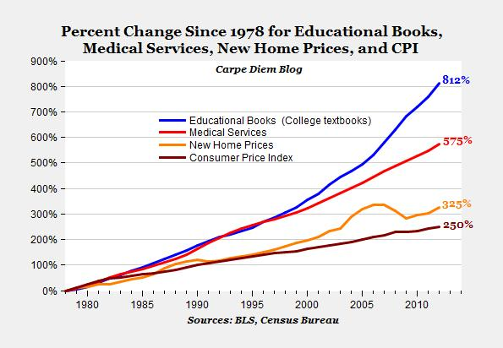
Notes:
Mark J. Perry, “The college textbook bubble and how the “open educational resources” movement is going up against the textbook cartel,” Carpe Diem, December 24, 2012.

Slide 9
Notes:
http://www.universitybusiness.com/article/college-textbook-forecast-radical-change-ahead

Slide 13
“Could we, for example, write a collaborative U.S. history textbook that would be free to all our students?”
Roy Rosenzweig, 2006
Notes:
Roy Rosenzweig, “Can History Be Open Source? Wikipedia and the Future of the Past,” The Journal of American History (June 2006), 119.

Slide 14
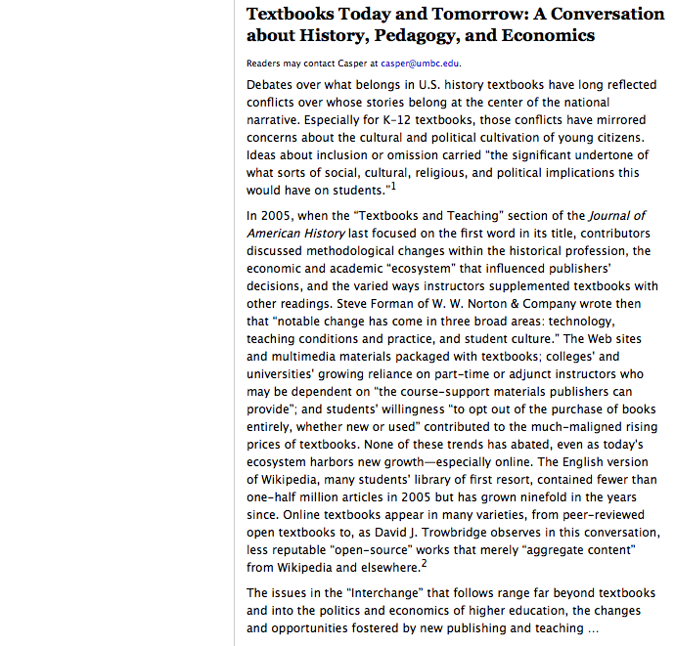
“Overall, however, my impression is that the textbook itself and the use of the textbook in introductory history survey classes has not changed much in the last decade.”
Eric Foner
“Bad writing abounds in open- source materials, which tend to read more like chronologies of U.S. history than analyses.”
Amy Kinsel

Slide 15
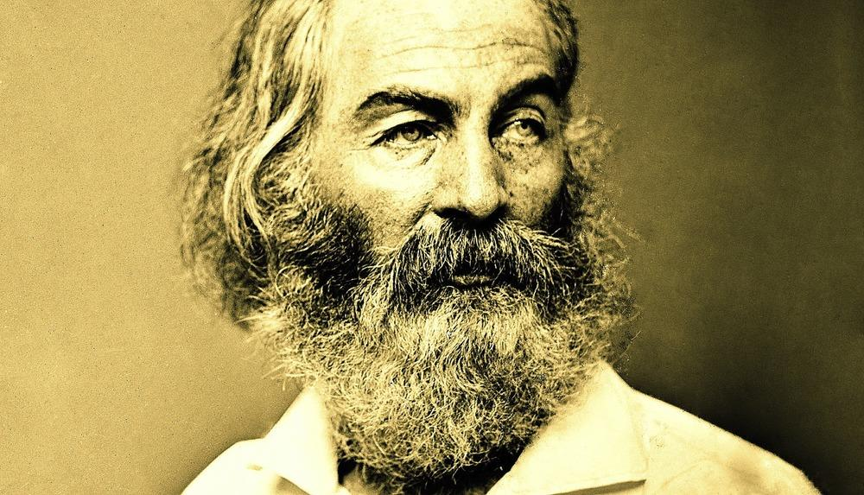
“I sound my barbaric yawp over
the roofs of the world.”

Slide 16
How should historians collaborate?
Notes:
Roy Rosenzweig, “Can History Be Open Source? Wikipedia and the Future of the Past,” The Journal of American History (June 2006), 119.

Slide 17
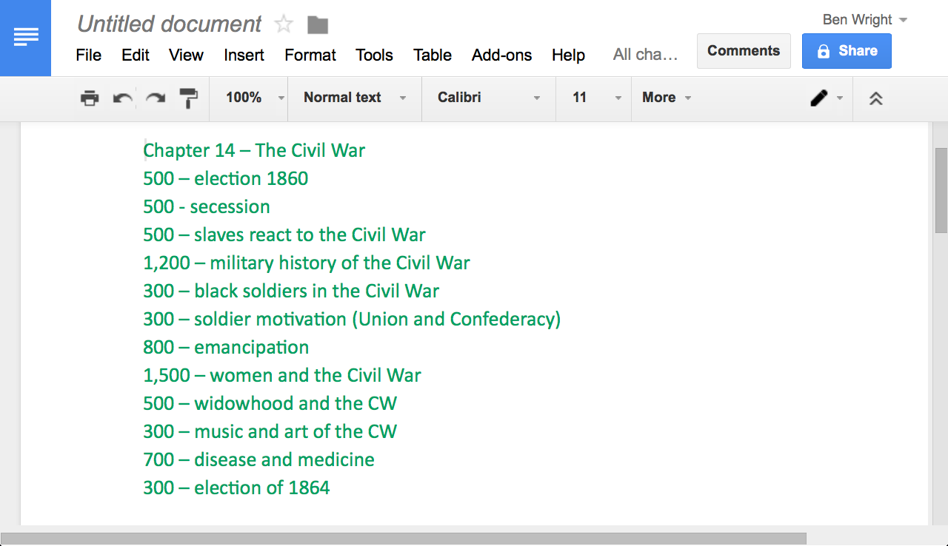

Slide 18
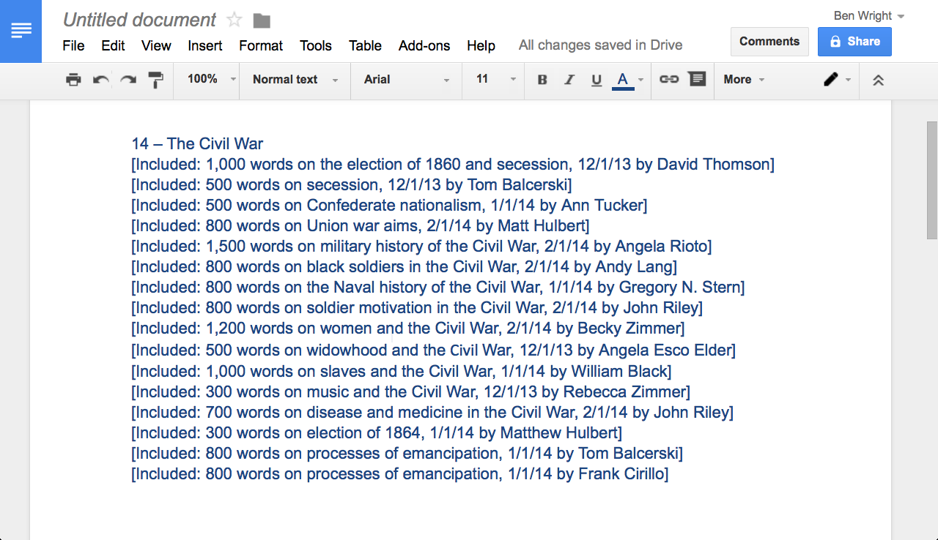

Slide 19
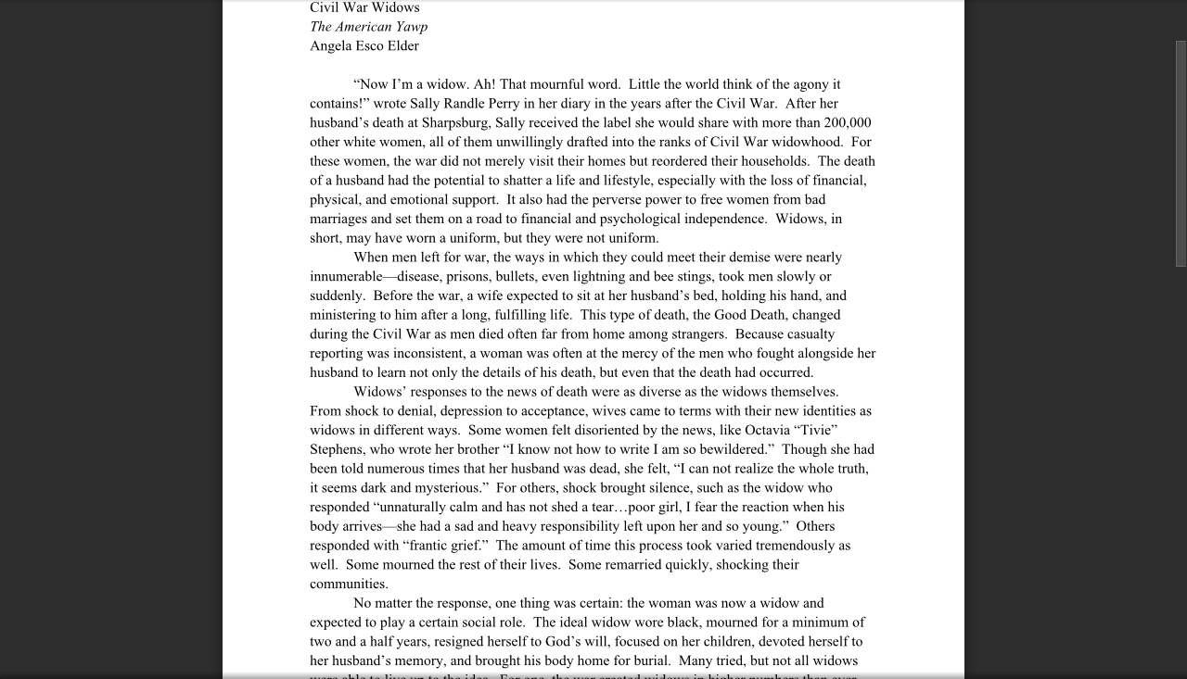

Slide 20
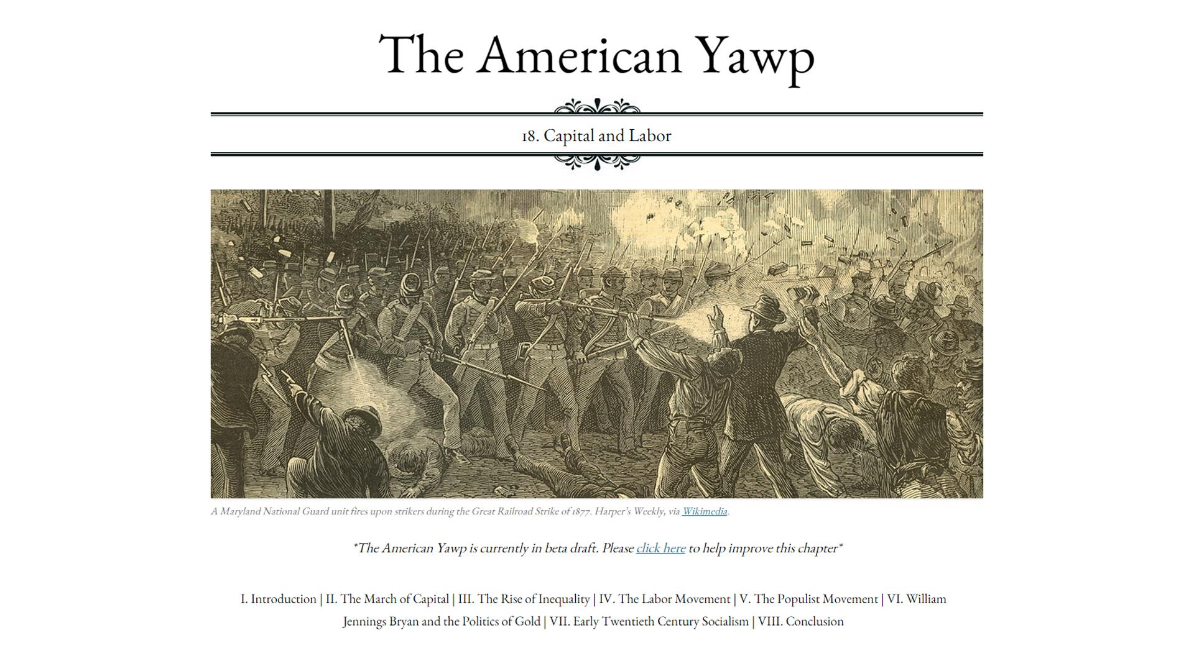

Slide 21
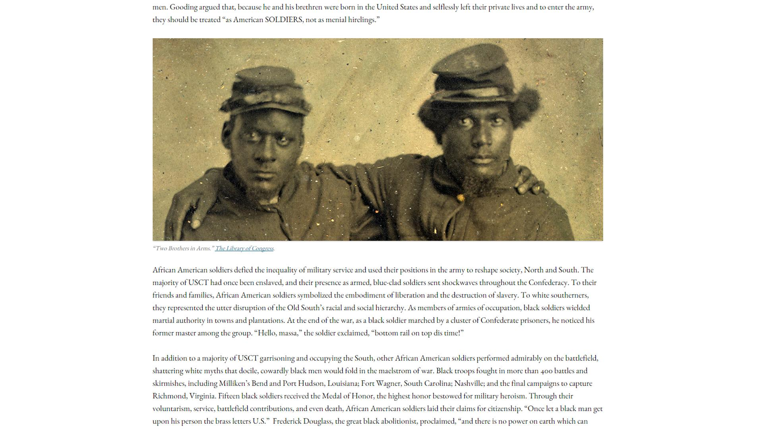

Slide 22
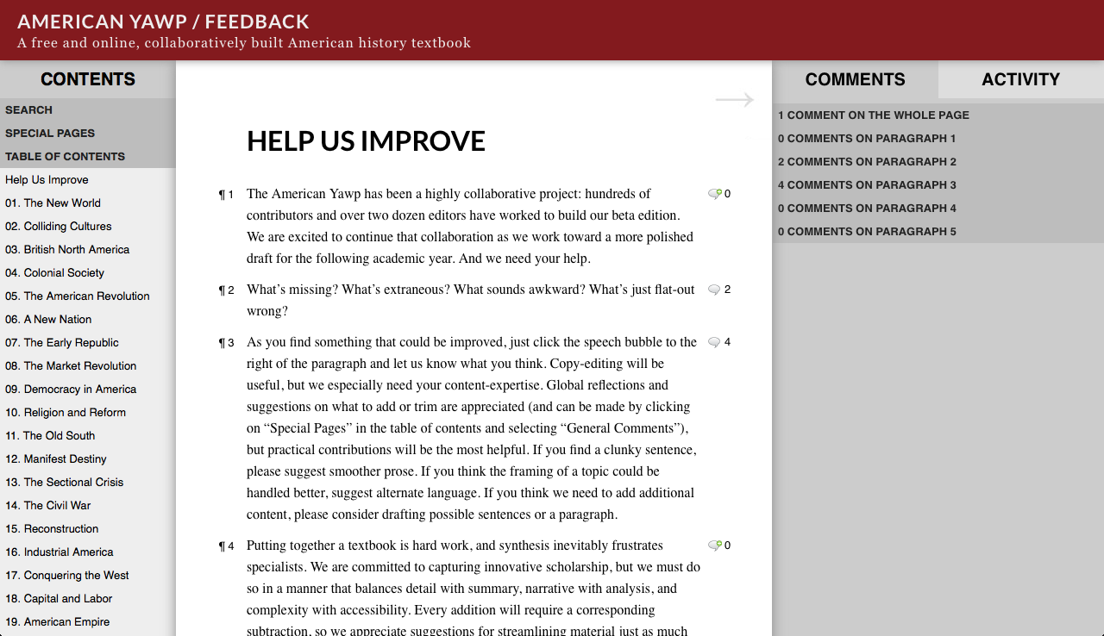

Slide 24
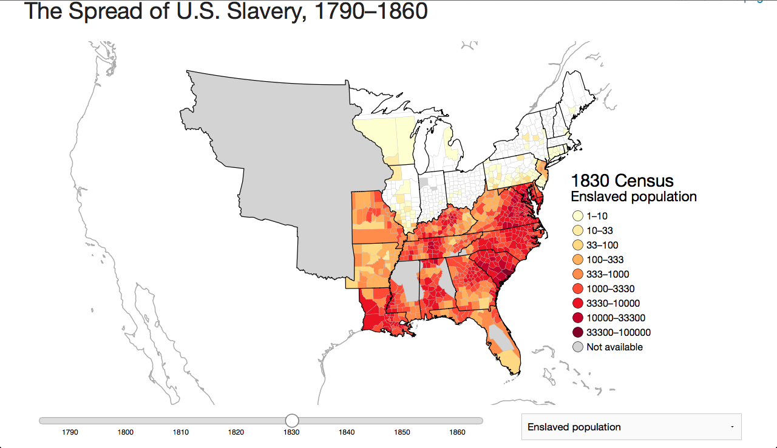

Slide 25
Have the digital humanities fulfilled their democratic promise?
What practical problems can the digital humanities solve?
How should historians collaborate?
Notes:
Roy Rosenzweig, “Can History Be Open Source? Wikipedia and the Future of the Past,” The Journal of American History (June 2006), 119.

Slide 26
A question for you:
Notes:
Roy Rosenzweig, “Can History Be Open Source? Wikipedia and the Future of the Past,” The Journal of American History (June 2006), 119.

Slide 27
A question for you:
Where do we go from here?
Notes:
Roy Rosenzweig, “Can History Be Open Source? Wikipedia and the Future of the Past,” The Journal of American History (June 2006), 119.

